Slide 1
Dunnhumby Cereal: National vs Private
Team 23: Amy Fischbach, Nikitha Balaji, Rupali Kakadia
12/8/2024

Slide 2
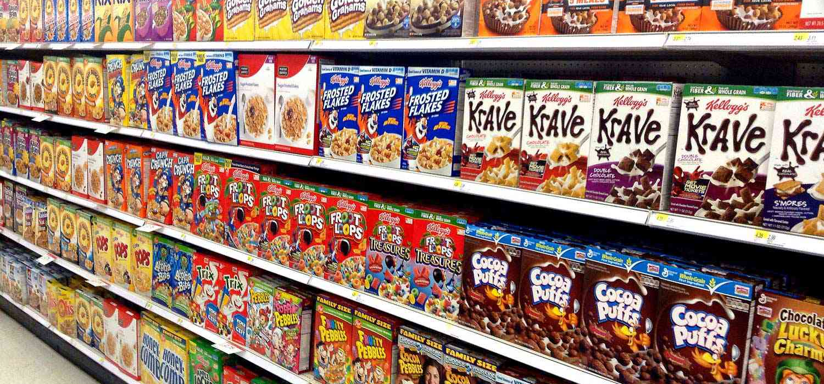
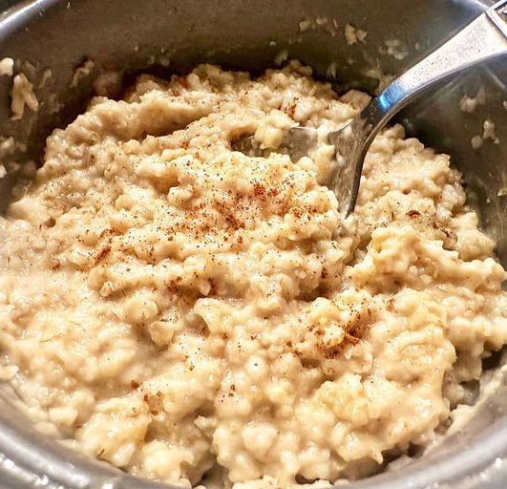
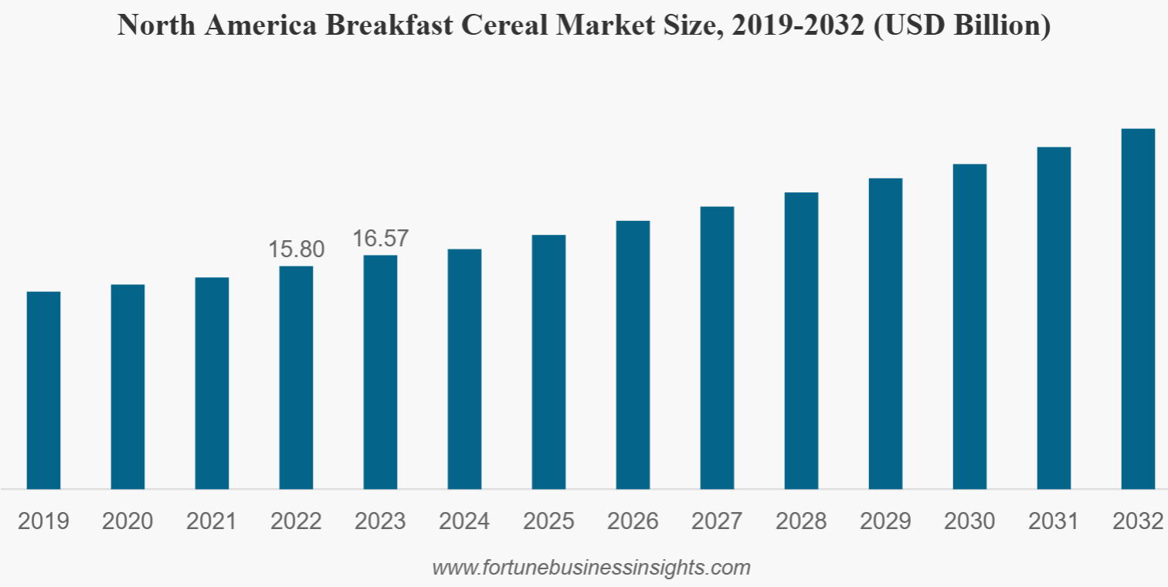
Ready-Made Breakfast in Supermarkets
A high-grossing marketing with multiple players in the market for extreme competition
$22.53B in revenue in 2024 and expected to grow annually by 2.39%
Highly competitive, with various companies competing for market share
Notes:
https://market.us/report/frozen-breakfast-foods-market/
https://www.statista.com/outlook/cmo/food/bread-cereal-products/breakfast-cereals/united-states
https://www.fortunebusinessinsights.com/industry-reports/breakfast-cereals-market-100535

Slide 3
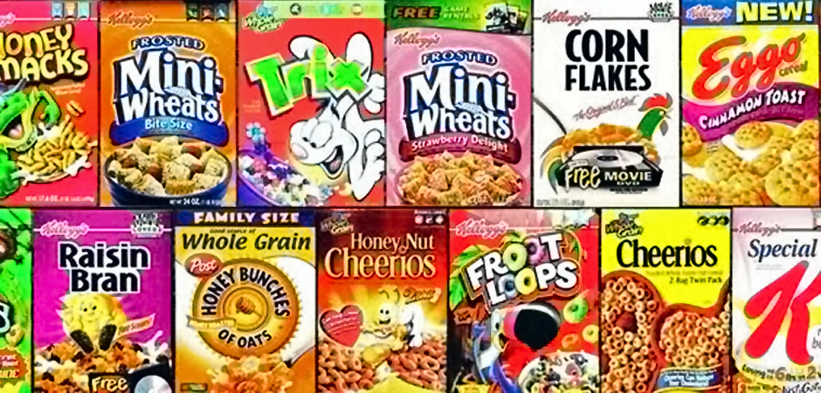
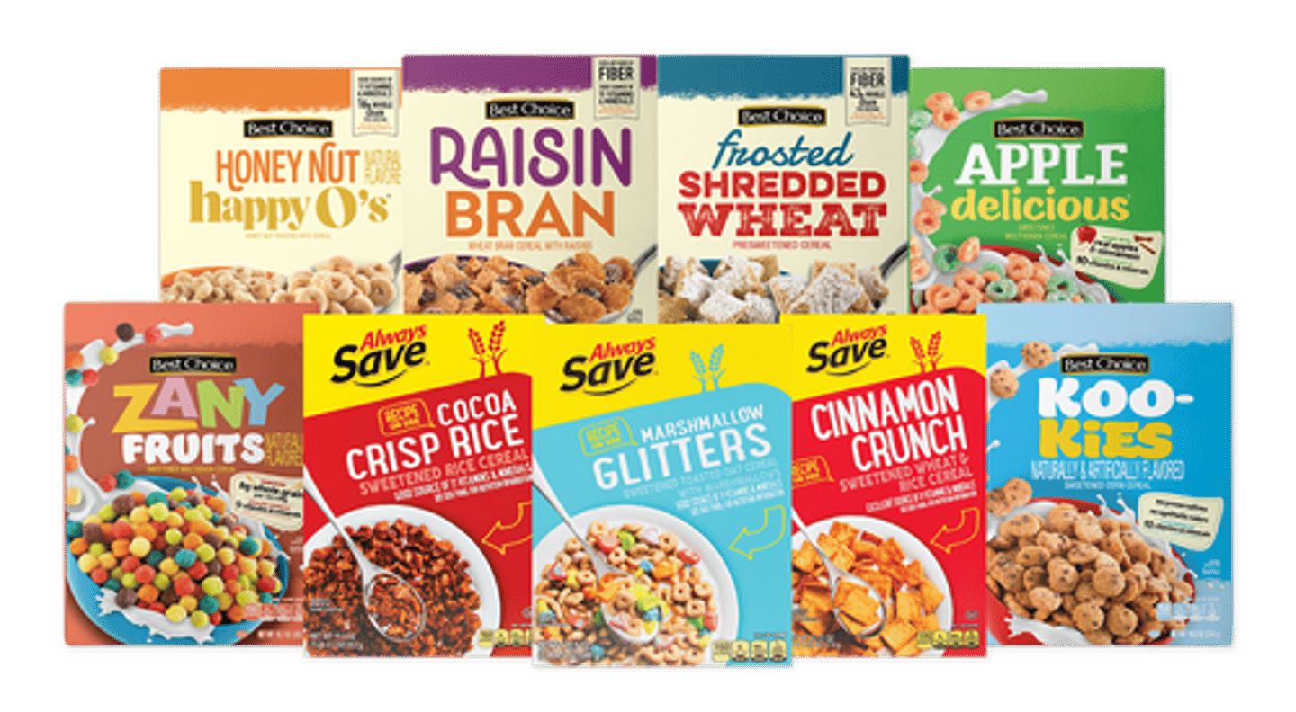
National and Private Labels
Cereal divided into National Labels vs Private labels (retailer or wholesale manufacturer)
National Labels
Private Labels
Post
Kellogg's
General Mills
Quaker Oats
365 Everyday Value
Great Value
Equate
Marketside
Notes:
https://www.relocalize.com/blog/what-is-private-label-food

Slide 4
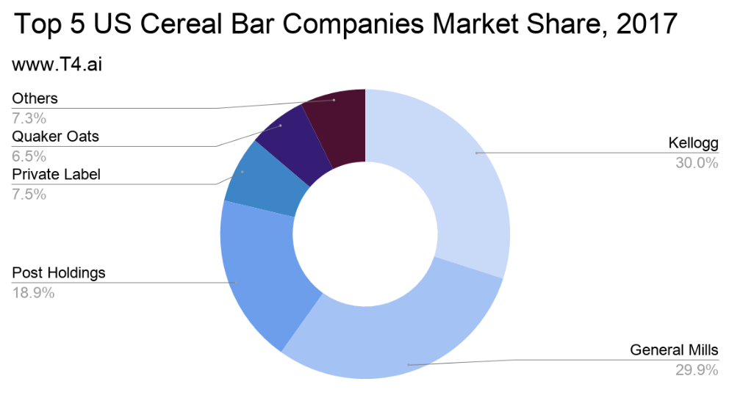
Overall Market Share in Global Industry
National Brands Kellogg’s and GM dominate at ~60% market share overall
Kellogg and General Mills top national brand players
Private Label brands account for 7.5% overall
We’ll be focusing on national vs private labels to see how Private labels can perform more effectively to gain market share and compete with the top National label players
Notes:
https://www.t4.ai/industries/cereal-companies-market-share

Slide 5
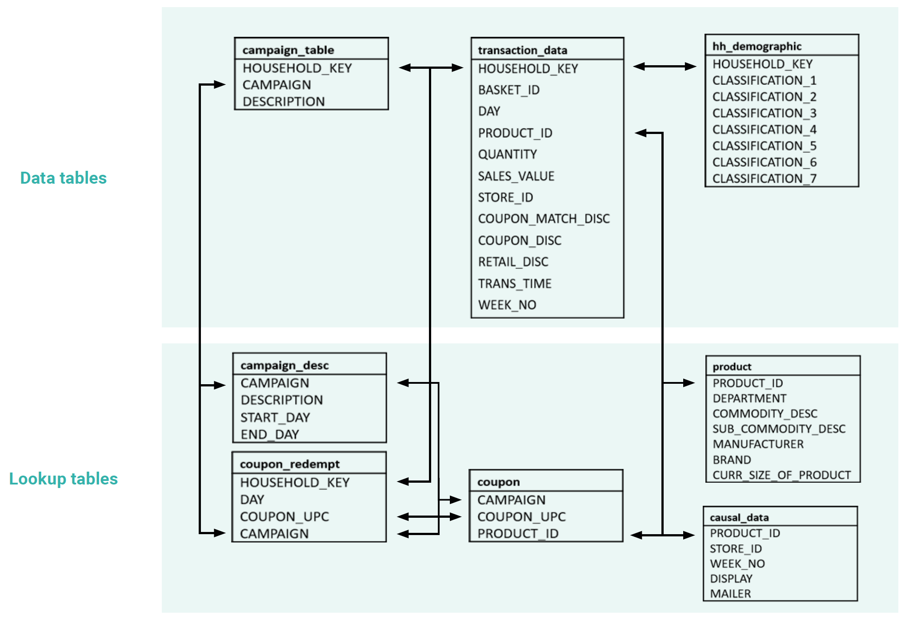
Data Sources to Utilize
A high-grossing marketing with multiple players in the market for extreme competition
Transaction_data, hh_demographics, and campaign_table provide robust supermarket data to show trends in spend
Lookup tables add robustness to results to allow for more actionable interpretation
Larger data sets (transaction_data and causal_data) filtered out to just cereal to make analysis easier, along with cleaning data to standardize it

Slide 6
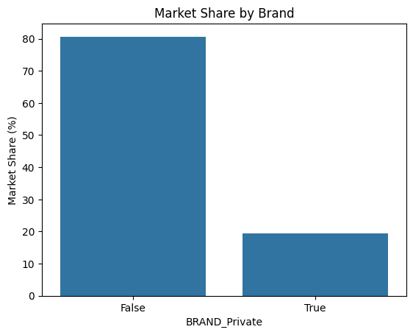
Market Share
National Brands hold the majority of the market share at more than 80%!

Slide 7
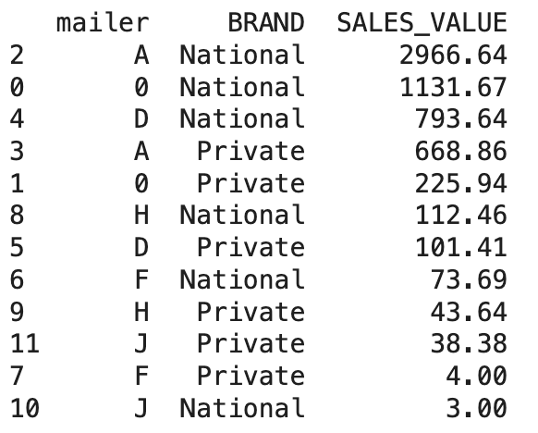
Mailer
For National Brands (Competitor), mailer option A (which is Interior page feature) seemed to generate most sales for both National and Private Brands. Ironically, option 0 (which is the no ad option) generated the second highest sales.

Slide 8
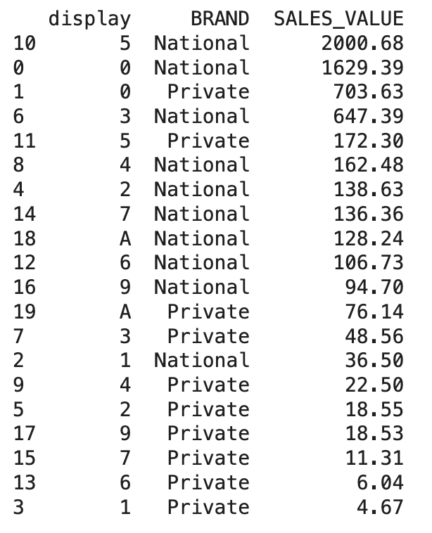
Display
For National Brands (Competitor), display option 5 (which is Rear End Cap) seemed to generate most sales for both National Brands. For Private Brands, no display apparently generated more sales which points to perhaps having more online sales.

Slide 9
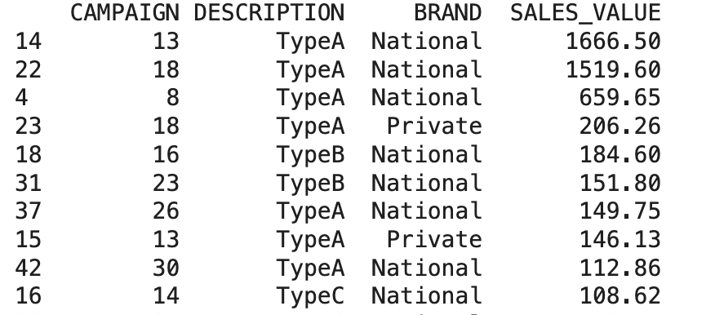
Campaign
For National Brands, Campaigns 13 and 18 generated most sales, which was the same for Private Brands as well.

Slide 10
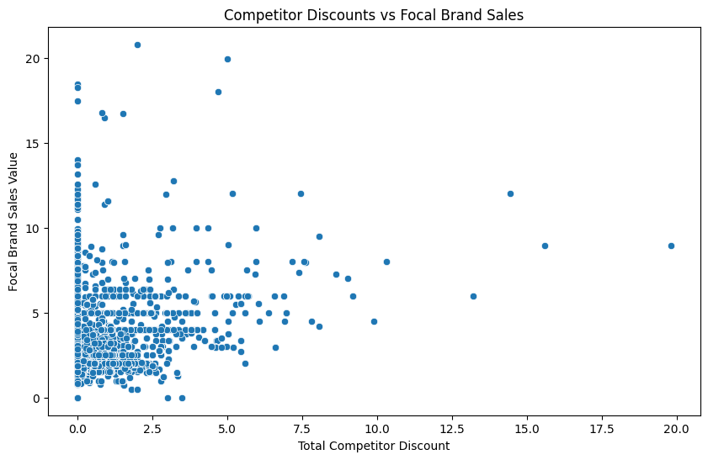
Effect of Competitor Discount
As seen, as Competitor Discount increases, sales of Private Brands decrease.

Slide 11
Competitor Pricing Analysis: Impact on Private Label Sales
Objective: To analyze competitors' pricing strategies and forecast their potential impact on private label sales
Steps in the process
Merged relevant datasets to include key features (WEEK_NO, display, mailer) and target variable (average_price)
Dropped uninformative features (retail_disc, coupon_disc) with constant values
Checked for missing values and ensured data consistency
Data Preperation
Model Building (Gradient Boosting)
Forecasting
Trained a Random Forest Regressor to predict competitors' average prices
Evaluated the model using Mean Squared Error (MSE) to ensure accuracy
Created a dataset for future weeks (WEEK_NO 103–109) with cyclic trends in display and mailer features
Used the trained model to predict competitors' average prices for the forecast period
Analyzed feature importance to validate the influence of display and mailer

Slide 12
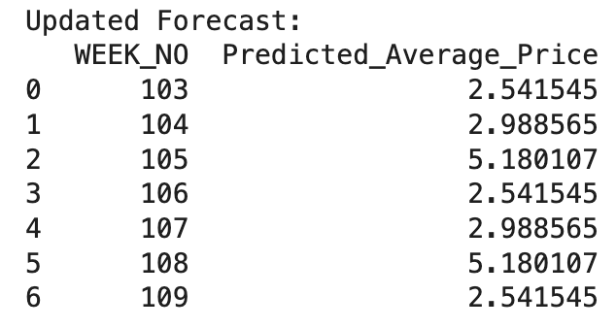
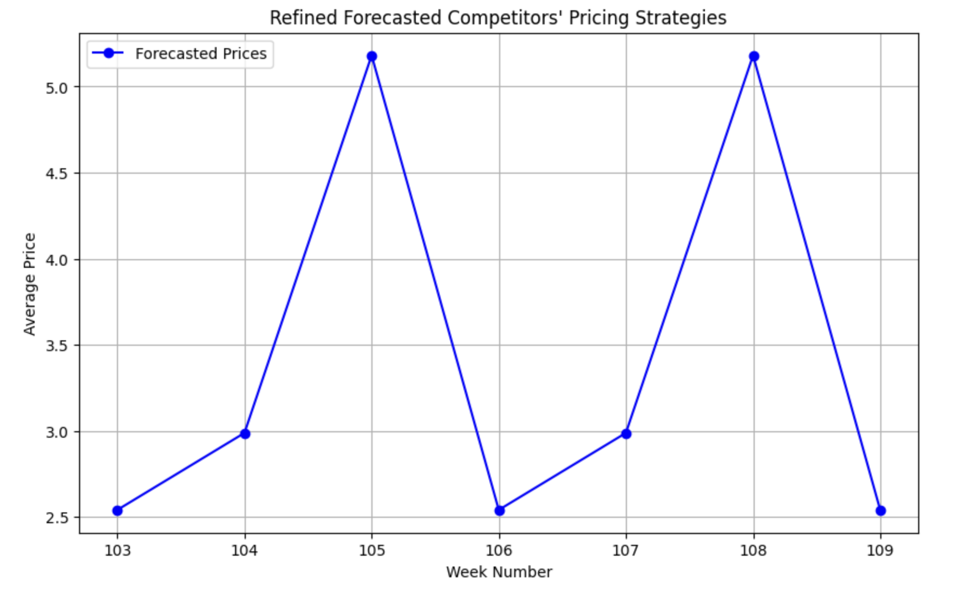
Results: Predicting Pricing Scenarios

Slide 13



Strategic Recommendations and Takeaways
Optimize Pricing Strategy: Adjust private label prices based on competitors' promotional cycles (e.g., reduce prices during weeks with higher competitor prices such as weeks 105 and 108).
Target Demographics: Focus on specific customer segments (e.g., high-value customers during low-price weeks like 103, 106, and 109) to increase sales during periods of lower competitor prices.
Key Takeaways: The forecasting model predicts price fluctuations across the upcoming weeks, revealing opportunities for price adjustments. Competitors’ pricing strategies should be closely monitored for optimal positioning.

Slide 14
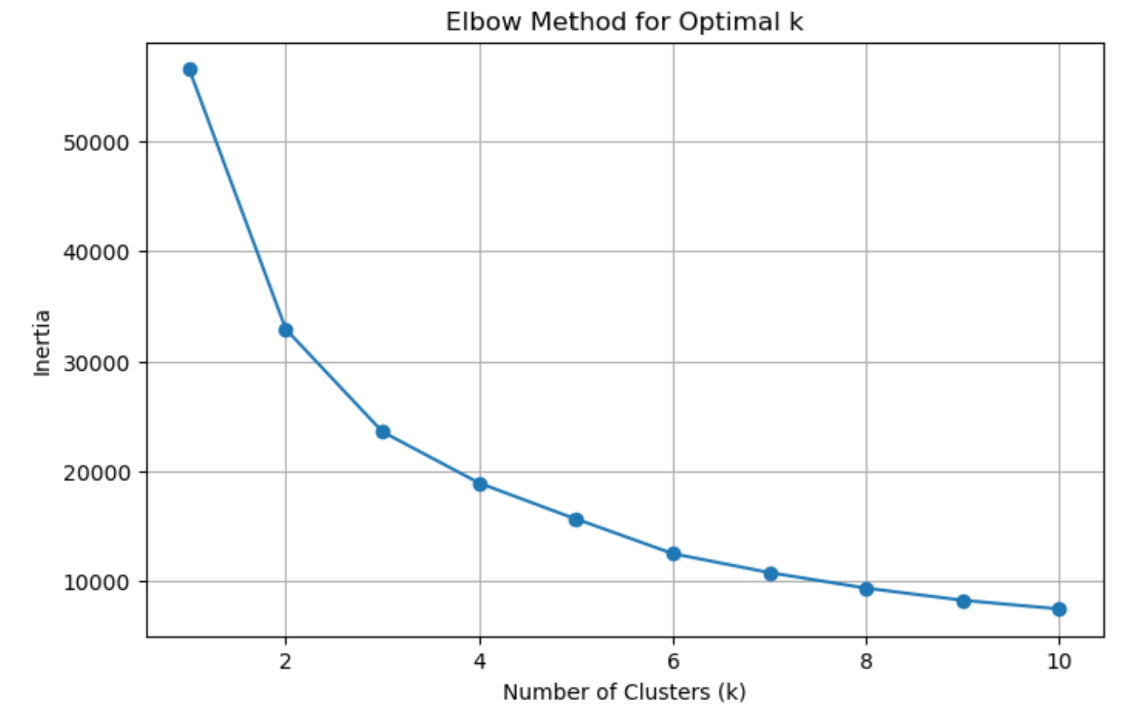
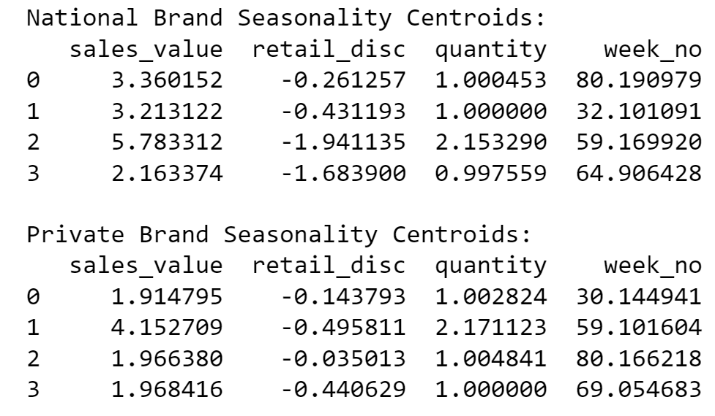
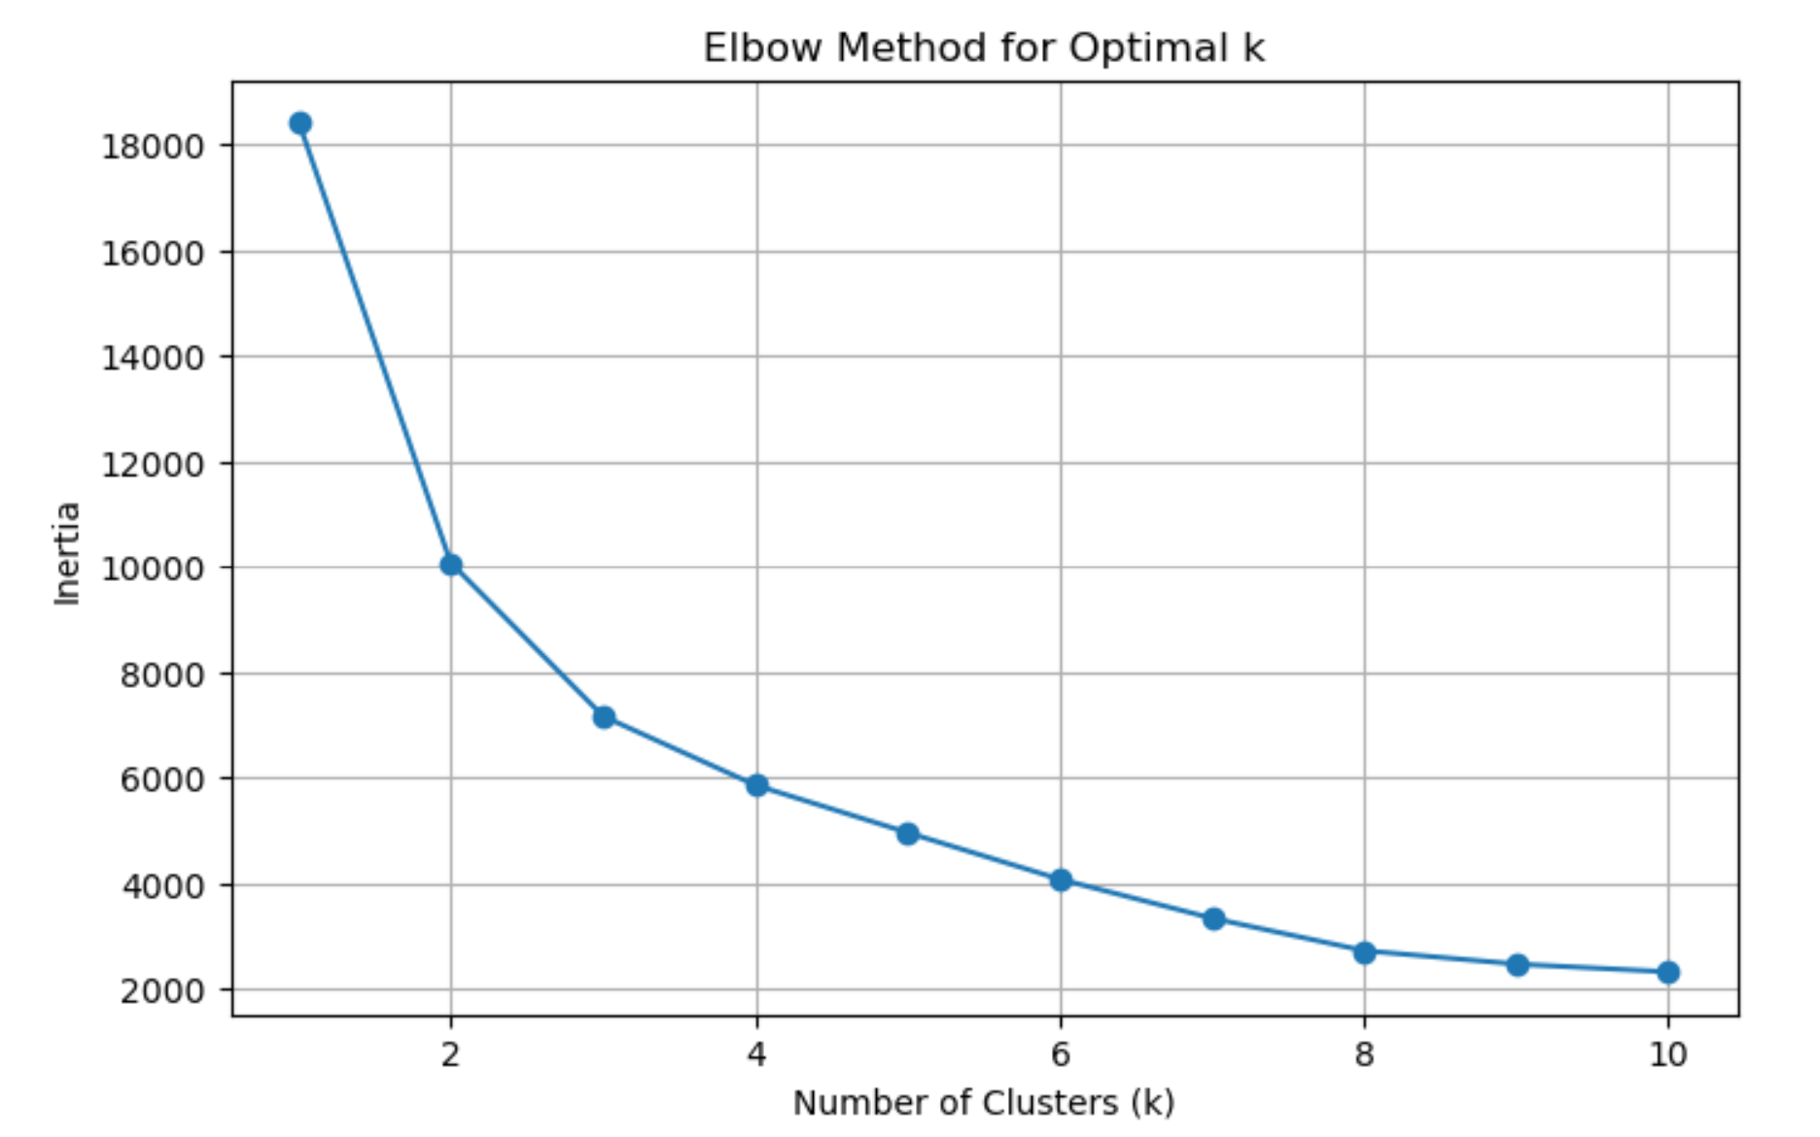
K-Means Cluster Analysis shows clusters at k=4
National
Private

Slide 15
National Seasonal Clusters Descriptions
Deep diving into 4 segments for each label type
Cluster 0 | Cluster 1 | Cluster 2 (Premium) | Cluster 3 (Value)
Sales Value: $3.36 (moderately priced) Retail Discount: Minimal (-0.26) Quantity: 1.00 (standard volume) Week No: 80.19 (later in the year) Description: These are moderately priced products with minimal discounts that sell steadily later in the year (e.g., fall or pre-holiday season). . | Sales Value: $3.21 (moderately priced) Retail Discount: Slight (-0.43) Quantity: 1.00 (standard volume) Week No: 32.10 (mid-year) Description: These are moderately priced products but with slightly higher discounts, likely to sustain demand mid-year. | Sales Value: $5.78 (high-priced premium products) Retail Discount: Significant (-1.94) Quantity: 2.15 (high volume) Week No: 59.17 (late summer or early fall) Description: Premium products with deep discounts to drive bulk purchases during seasonal peaks. | Sales Value: $2.16 (budget-priced) Retail Discount: Deep discounts (-1.68) Quantity: 1.00 (standard volume) Week No: 64.91 (early fall) Description: Low-priced products targeted at cost-conscious buyers, using aggressive discounting during early fall. .

Slide 16
Private Seasonal Clusters Descriptions
Deep diving into 4 segments for each label type
Cluster 0 | Cluster 1 (Premium) | Cluster 2 | Cluster 3
Sales Value: $1.91 (low-priced) Retail Discount: Minimal (-0.14) Quantity: 1.00 (standard volume) Week No: 30.14 (mid-year) Description: Budget products with almost no discounts targeting price-sensitive customers during mid-year. | Sales Value: $4.15 (upper mid-range pricing) Retail Discount: Moderate (-0.49) Quantity: 2.17 (high volume) Week No: 59.10 (late summer/early fall) Description: Upper mid-range products with higher purchase volumes, promoted through moderate discounts during seasonal peaks. | Sales Value: $1.97 (low-priced) Retail Discount: Minimal (-0.03) Quantity: 1.00 (standard volume) Week No: 80.16 (later in the year) Description: Budget products with negligible discounts sold during late-year periods. | Sales Value: $1.97 (low-priced) Retail Discount: Moderate (-0.44) Quantity: 1.00 (standard volume) Week No: 69.05 (early fall) Description: Budget-friendly products with slightly higher discounts targeted during early fall.

Slide 17
Targeting Certain Clusters to Increase Sales
What? | How? | Why?
Expand Presence in Premium Segments | Increase discounting slightly for Cluster 1 products to appeal to customers who seek value but are willing to pay more for quality during late summer/fall. | Premium Clusters (C2 for National and C1 for Private) sell same quantity for both, but National has higher sales value with more discounting than Private
Dominate the Budget Segment | Use aggressive pricing and discounting (like Cluster 3 for early fall) to gain market share from national brands. Promote the equivalence in quality to national brands through packaging, advertising, and in-store promotions. | 3 out of 4 clusters target budget customers for private brands, but have a variety of discounts that are lower than what national uses for its budget cluster (Cluster 3)
Seasonal Promotions | Focus on seasonal marketing campaigns for Cluster 1 products in late summer/fall. Offer bundled deals (e.g., "back-to-school" or "holiday savings") to attract bulk purchases. | National brands excel in leveraging seasonality with significant sales during late summer/fall (Cluster 2: $5.78, week_no 59). Private does well but has room to grow.
Holiday Season Strategy | Highlight the price advantage of private label Cluster 2 products during the holiday season. Invest in eye-catching seasonal packaging to compete with national brands. | Cluster 0 of National excels in late-year sales with $3.36 sales value and minimal discounting. Private’s Cluster 2 in the same period has a $1.97 sales value with negligible discounts.
Compete on Bulk Purchases | Leverage the higher quantity metric by bundling Cluster 1 products with complementary items or other products to increase perceived value. Offer loyalty program incentives for repeat bulk purchases. | Cluster 2 of National has strong bulk sales ($5.78, quantity 2.15) while Cluster 1 of Private performs similarly with $4.15 sales value and quantity 2.17.

Slide 18
Seasonal Demo Clusters Descriptions
Deep diving into 4 customer segments for each label type
Cluster 0 | Cluster 1 | Cluster 2 | Cluster 3
Quantity: 1.08 (Moderate quantity purchases). Sales Value: $2.99 (Low spending per transaction). Retail Discount: -0.49 (Moderate discounts received). Age Groups: Heavily skewed towards Age Groups 5 and 6 (older demographic). Week Number: Average purchase week is ~55 (mid-year purchases). Description: This cluster represents older consumers who are moderately sensitive to discounts and purchase small quantities at low price points. | Quantity: 1.09 (Moderate quantity purchases). Sales Value: $2.98 (Low spending per transaction). Retail Discount: -0.64 (High discounts received). Age Groups: Dominated entirely by Age Group 3 (middle-aged consumers). Week Number: Average purchase week is ~57 (later in the year). Description: This cluster comprises middle-aged consumers who are highly discount-sensitive. Their purchases are focused on value and savings. | Quantity: 1.06 (Slightly lower quantities). Sales Value: $2.92 (Lowest spending per transaction). Retail Discount: -0.64 (High discounts received). Age Groups: Entirely Age Group 2 (younger consumers). Week Number: Average purchase week is ~59 (end of the year). Description: Younger consumers dominate this cluster. They are highly price-sensitive and prefer deeper discounts, but their overall purchase quantity is lower. | Quantity: 1.10 (Slightly higher quantities). Sales Value: $3.00 (Highest spending per transaction). Retail Discount: -0.59 (Moderate discounts received). Age Groups: Skewed towards Age Group Week Number: Average purchase week is ~57 (later in the year). Description: Consumers in this cluster are slightly less price-sensitive and purchase higher quantities with a slightly higher spending threshold.

Slide 19
Demographic Cluster Recommendations
Who? | How? | Why?
Cluster 0 (Older Consumers - Age Groups 5 & 6): | Smaller Packaging: Cater to smaller households by offering private-label products in single servings or smaller packages. This aligns with their smaller purchase quantities. Moderate Price Cuts: Mid-size discounts (10%-15%) work for this group as they have moderate sensitivity to price changes. | Purchases are moderate in size and value, indicating these customers may be on fixed incomes. The reliance on discounts suggests price sensitivity, though less extreme compared to younger consumers.
Cluster 1: Middle-Aged Consumers (Age Group 3) | Deeper Discounts: Target this group with 20–25% discounts on private labels to compete directly with national brands. Value Messaging: Highlight savings in marketing campaigns. Use phrases like “Get more for less of your wallet!” | A slight increase in discount level (-0.64 compared to -0.49 in Cluster 0) shows this group is highly price-sensitive. Low sales value indicates cost-consciousness, even if they buy moderately higher quantities.
Cluster 2: Younger Consumers (Age Group 2) | Targeted Price Promotions: Offer discounts exceeding 25%, especially during promotional events, to capture attention and build brand loyalty among younger shoppers. | Lowest sales value and quantity suggest this group operates on a tight budget. High discount reliance shows their preference for value.
Cluster 3: Higher Quantity Buyers (Age Group 4) | Bulk Sizes: Offer private-label products in family-sized or bulk packaging to match their higher purchase quantities. Premium Positioning: Introduce private-label tiers with superior quality and packaging to compete with national brands, leveraging their higher spending potential. | Higher quantity and sales value suggest this group includes larger households or bulk buyers. Their discount reliance (-0.59) is moderate, indicating some willingness to pay for quality.

Slide 20
Final Recommendations for Private Labels
Enhance Marketing Campaigns: Emphasize interior page mailers (Option A) in promotional campaigns, as these have proven to boost sales for both private and national brands.
Strengthen Online Presence: Given private labels’ success with minimal physical display, enhance online shopping experiences through targeted ads, user-friendly websites, and digital discounts.
Invest in Display: Experiment with minimal yet strategic in-store placements that complement their digital-first approach.
Promotions and Discount: Provide competitive retail discounts that align with periods of reduced national brand promotions.
From Competitor Pricing Analysis:
Adjust private label prices based on competitors' promotional cycles, reducing prices during weeks with higher competitor prices, such as weeks 105 and 108.
Focus on high-value customers during weeks with lower competitor prices, like weeks 103, 106, and 109, to drive sales.
The forecasting model highlights price fluctuation trends, offering opportunities for strategic pricing adjustments while emphasizing the importance of monitoring competitors' strategies.
From Clustering:
Targeting Premium segments to compete with National Brands
Marketing campaigns to target seasonal and holiday shopping
Targeting certain products with specific discounts to drive sales
Making changes to promotions for specific demographics to increase sales
Here

Slide 21
Thank You!

Slide 22
Appendix

Slide 23
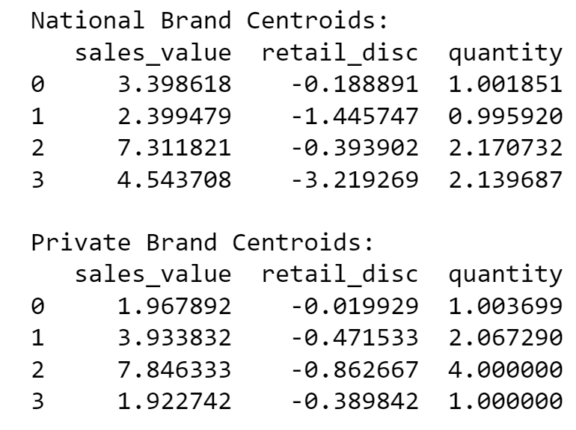
K-Means Cluster Analysis Without Seasonality
National
Private

Slide 24
Demographics Clusters with Seasonality
Cluster | quantity | Sales value | Retail disc | week_no | AgeGroup2 | AgeGroup3 | AgeGroup4 | AgeGroup5 | AgeGroup6
0 | 1.08 | 2.99 | -0.50 | 55.24 | 1.42E-15 | 3.89E-15 | -6.66E-16 | 4.41E-01 | 5.59E-01
1 | 1.09 | 2.98 | -0.64 | 57.35 | -5.69E-15 | 1 | 1.22E-15 | 7.84E-16 | -5.97E-16
2 | 1.06 | 2.92 | -0.64 | 58.69 | 1 | -8.33E-16 | 6.99E-15 | 6.87E-16 | -1.32E-15
3 | 1.10 | 3.00 | -0.59 | 57.86 | -3.83E-15 | 1.10E-14 | 8.58E-01 | 8.47E-16 | 1.76E-15

Slide 25
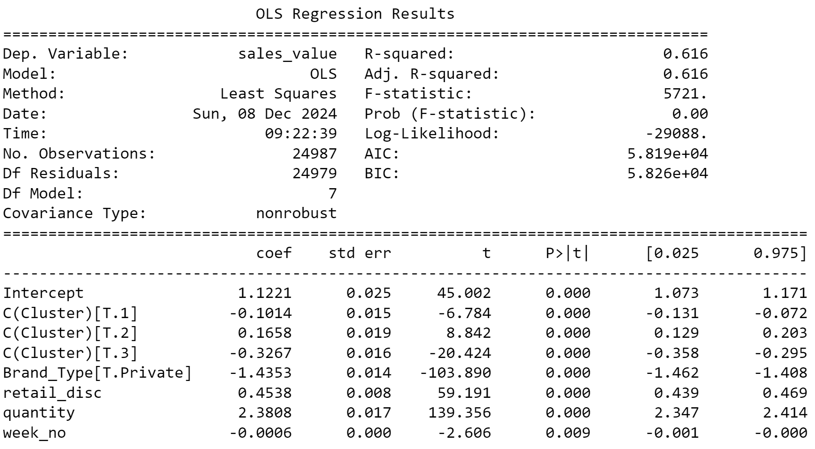
Running Regression on Cluster Analysis
Looking at spending to see how to further address customer needs

Slide 26
Coefficient Interpretation for Regression with Clusters
Brand_Type (Brand_Type[T.Private] = -1.4353, p < 0.001):
Private brand purchases are associated with a $1.435 decrease in sales_value compared to national brands, holding other variables constant.
Implication: Customers spend significantly less on private brands compared to national brands.
Retail Discount (retail_disc = 0.4538, p < 0.001):
For every unit increase in retail_disc (discounts offered), sales_value increases by $0.454.
Implication: Discounts drive higher sales, likely due to increased demand at lower prices.
Quantity (quantity = 2.3808, p < 0.001):
For each additional unit purchased, sales_value increases by $2.381.
Implication: Larger basket sizes significantly drive higher sales.
Week Number (week_no = -0.0006, p = 0.009):
For every additional week in the year, sales_value decreases by $0.0006.
Implication: Sales slightly decline as the year progresses, possibly due to seasonality effects (e.g., fewer purchases post-holiday season).
Clusters (C(Cluster)):
Cluster 1 (coef = -0.1014, p < 0.001):
Customers in Cluster 1 spend $0.101 less on average compared to the reference cluster (Cluster 0).
Implication: Cluster 1 exhibits slightly lower spending patterns.
Cluster 2 (coef = 0.1658, p < 0.001):
Customers in Cluster 2 spend $0.166 more on average compared to Cluster 0.
Implication: Cluster 2 customers are more valuable in terms of spending.
Cluster 3 (coef = -0.3267, p < 0.001):
Customers in Cluster 3 spend $0.327 less on average compared to Cluster 0.
Implication: Cluster 3 represents the least profitable group.

Slide 27
Targeting Certain Clusters to Increase Sales
What? | Data? | Recommendation?
Seasonality and Private Brands | Week_no has a small but significant negative coefficient, suggesting that sales for private brands decline slightly as the year progresses. | Private brands should focus on late-year promotions (e.g., holiday season) to sustain sales.
Product Clusters and Private Brands | Cluster 2 customers spend significantly more than other clusters. Cluster 3 customers spend the least, even less than the reference cluster | Focus on marketing private brands to Cluster 2 customers to maximize profitability. Re-engage Cluster 3 customers using targeted promotions or loyalty incentives.
Competitor Pricing and Discounts | Retail Discounts are strongly associated with higher sales, showing a positive elasticity. Private brands spend less overall than national brands . | Use competitive pricing strategies for private brands when competitors increase prices to capture market share Private brands can leverage higher discounts to attract cost-conscious customers.

